Slide 1

Lending club
2
+
2
+
DEFAULT PROBABILITIES AND SCORES

Slide 2


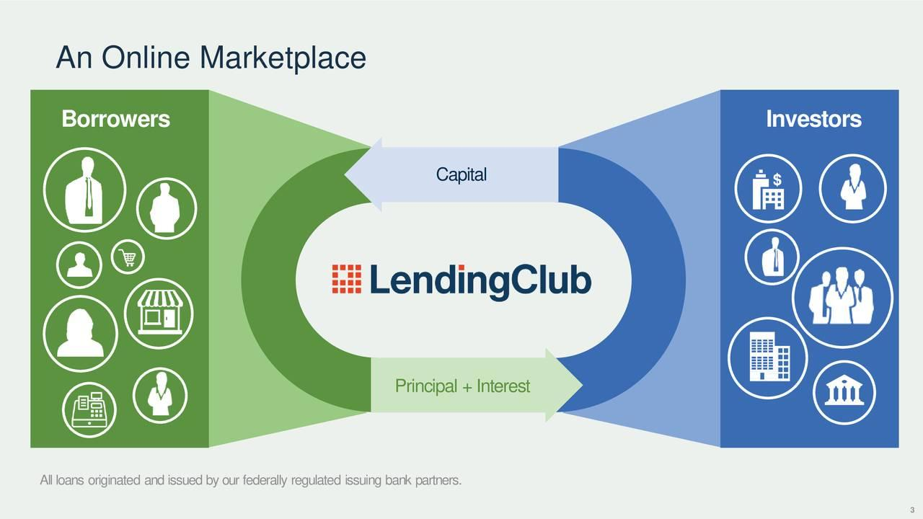
INTRODUCTION
2
+
2
+
Peer to Peer Lending
Process
Pros and Cons

Slide 3
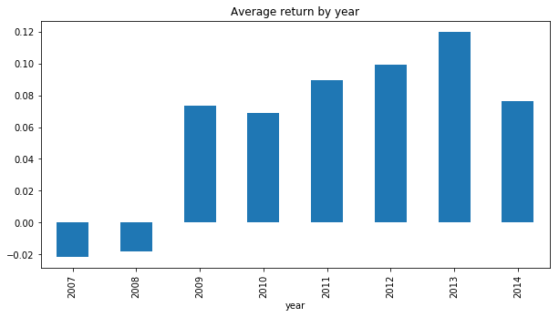
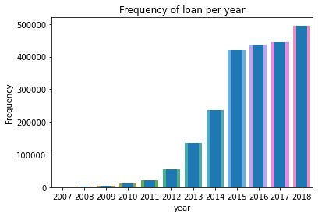
Loan frequencies
2
+
Investment return

Slide 4
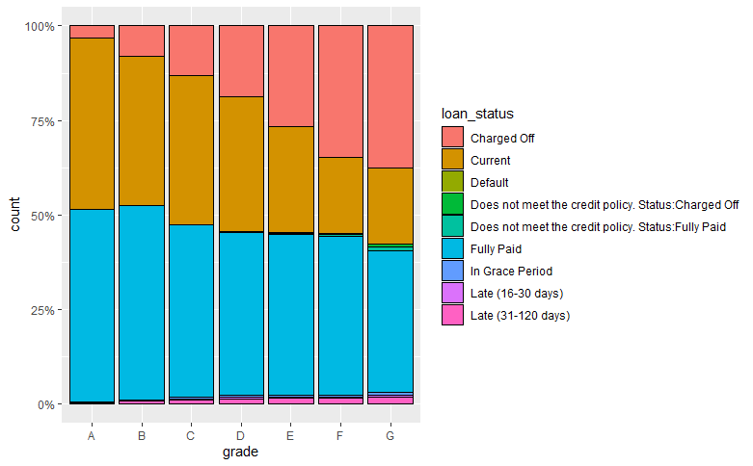
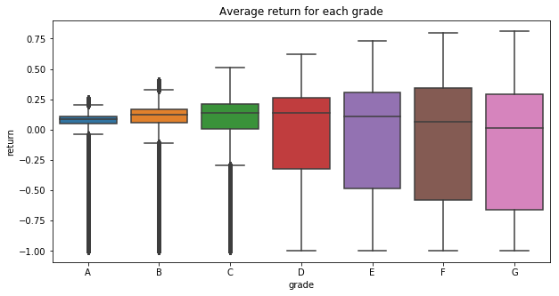
ANNUAL LOANS RETURNS BY GRADE
Loan classification

Slide 5
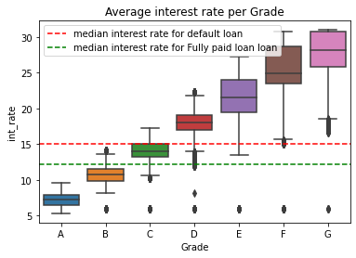
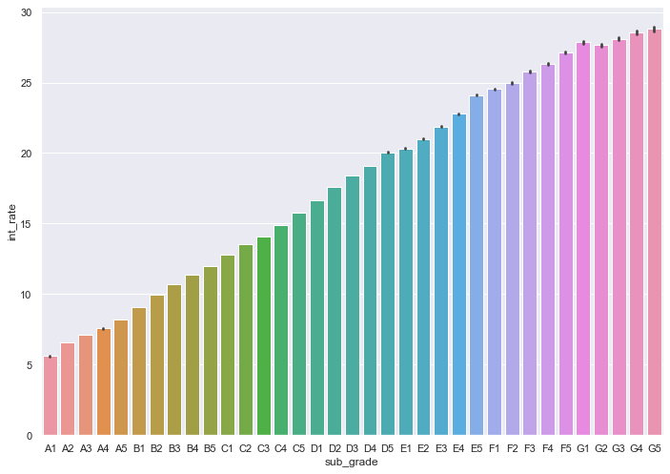
INTEREST RATES PER SUB-GRADE
INTEREST RATES PER GRADE

Slide 6
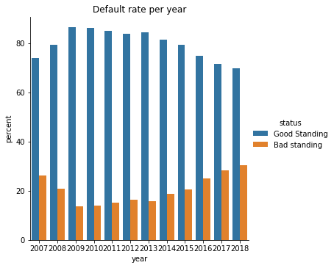
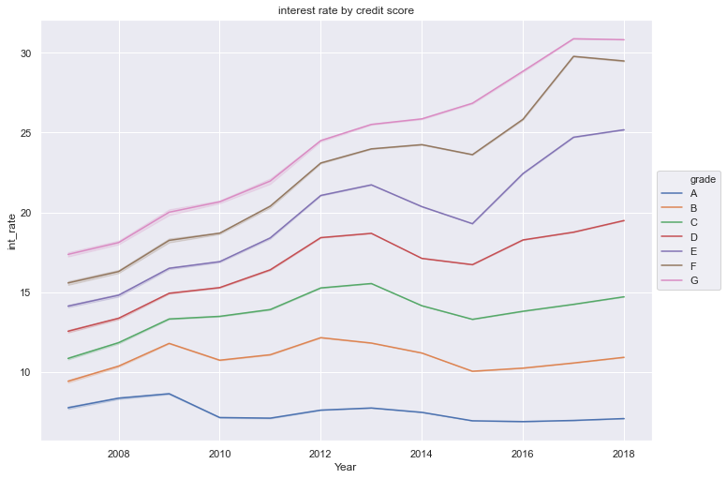
DEFUALT RATES
GRADE RATES VARIATION

Slide 7
Why Predict Financial loan data?
The Lending Club data gives us an opportunity to practice ML on a real world financial data set.
The data can provide investors the importance to which features of a loan they should pay attention to to maximize their chance of return.
This type of analysis is important to a variety of today’s finance companies and industries in order to predict who will pay back their loan and who would not.

Slide 8
Data Cleaning and Feature Engineering
Null values were replaced with meaningful values
Combine data from joint and secondary applicants
Maximize values for length of time, i.e. number of months from last bankruptcy, etc.
Create new columns to generalize certain features of the data set such as taking the mean of the FICO score and combining loan status
Numerate a lot of column data so that the model can extrapolate and perform better:
Applicant type is 1 for Individual or 2 for joint
Income verification is 1 for verified
Subgrade is now a value from 1-35
Only used data from 2013 onward

Slide 9
Training and Model Selection
Work was first performed on a partition of the data, 30% of the total 2+ million entries. This was to avoid overfitting
We decided to stick to tree based classification

Slide 10
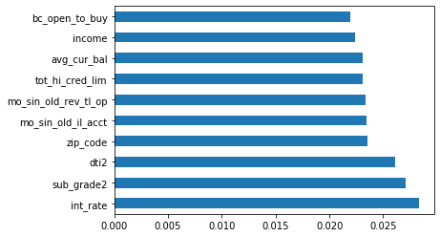
Random Forest
The data was now trained using a Random Forest and then tested for accuracy. The training was cross validated and tuned for maximum accuracy.
Accuracy: 86.6%

Slide 11
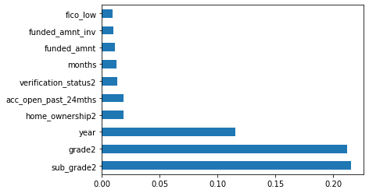
XGBoost
The Training data was also run using XGBoost and converting the data set to a sparse matrix. The data was again cross validated and parameters tuned to maximize accuracy.
Accuracy: 86.7%

Slide 12
Future Work
Future work with more time would be to try and continue improving the model for accuracy and seeing what additional feature engineering could be done.
We’d like to create a secondary model for seeing how we could maximize our returns by looking at the top revenue generating loans per year.

